Slide 1
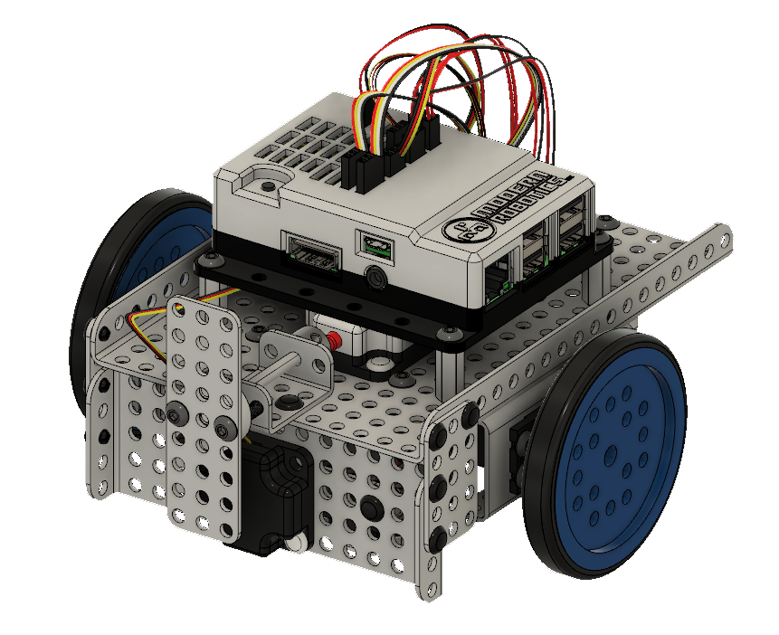
Mimio MyBot Base Kit Build Instructions

Slide 2
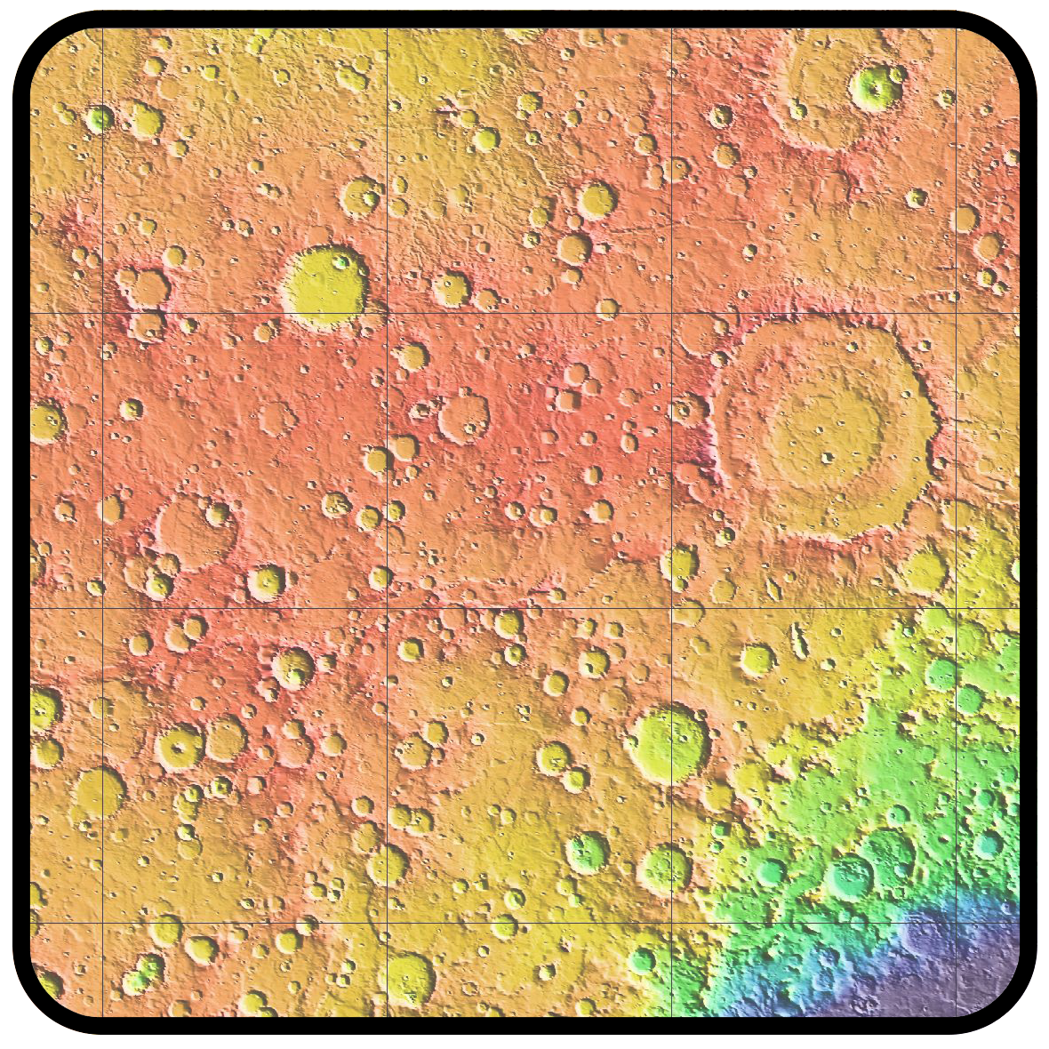
Mimio MyBot Planetary Exploration Kit Build Instructions

Slide 3
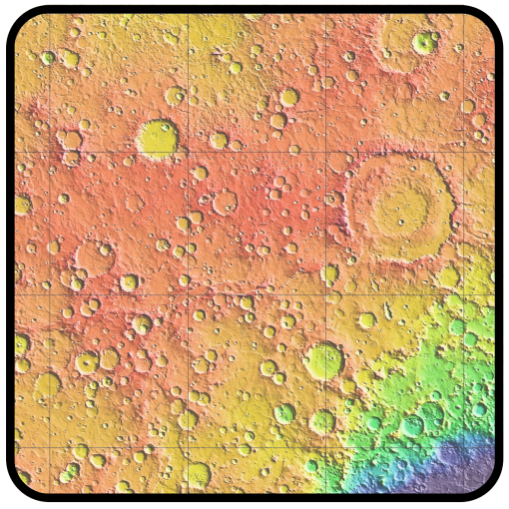
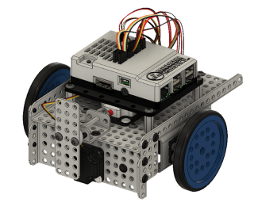

Adding the Planetary Exploration Pack to a MyBot BaseKit Robot

Slide 4
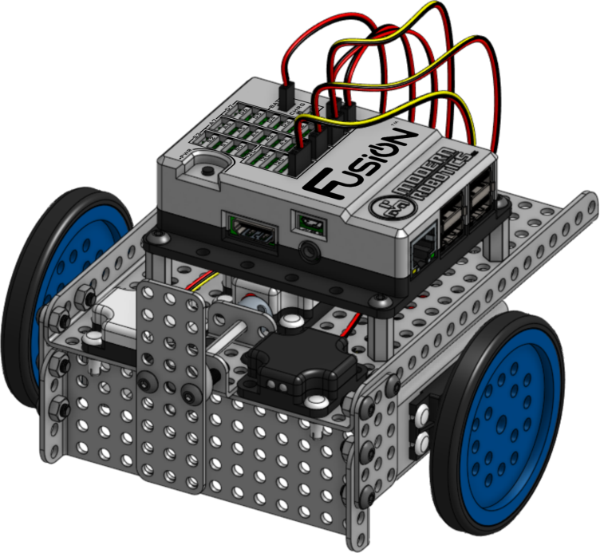
Base Bot
Building Instructions
Requires the Fusion Base Kit

Slide 5
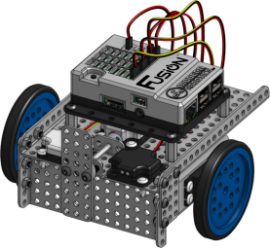
Adding the Planetary Exploration Pack to an Original MyBot BaseKit

